Slide 1
Bank Security
DevSecOps
#WhatWhyHowWhoWhen
CyberCon 2022
Vince King

Slide 2
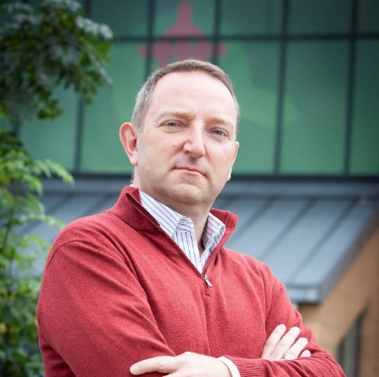
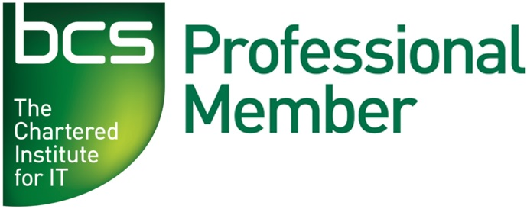

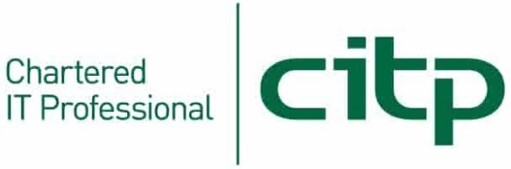


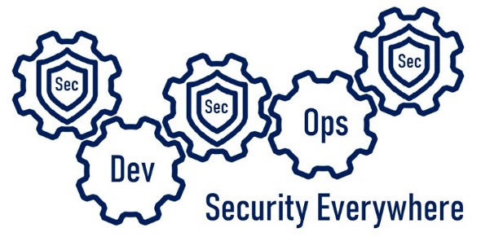

Who’s this talking to me now?
Vincent King
Senior Cyber Analyst
Head of DevSecOps
Bank of England
Vincent.king@bankofengland.co.uk
Reformed Developer
Secure Coding Subject Matter Expert
Qualys Certified Specialist
(ISC)² Certified Information Security Professional
DevSecOpsVince
Notes:
For those of you that do not know me, my name is Vince King, and I’ve been at the Bank for almost 10 years. I’m a reformed developer, and have numerous roles including Ops Lead and DevOps subject matter expert. I moved to Cyber 4 years ago working on Vulnerability Management and have been picking up as must experience (and as many certifications) as I can.
With my experience in DevOps and Cyber Security, I’m happy to lead the effort for DevSecOps within the Bank.
Now a word on what this presentation is, and more importantly, what this presentation is not. This presentation is an overview of what DeSecOps is; Why is it important; How we are going to “do” DevSecOps; Who is involved; and When it is happening.
This presentation is not a discussion of tooling or vendors. It is not a indepth course of best practice. Most importantly, it is not the silver bullet that will immediately implement DevSecOps.

Slide 3
What is CALMS?
Culture: people come first
Automation: rely on tools for efficiency and repeatability
Lean: apply Lean engineering practices to continuously learn and improve
Measurement: use data to drive decisions and improvements
Sharing: share ideas, information, and goals across silos
Notes:
A recipe for a successful transition to DevSecOps used by Netflix, Barclays, US Department of Homeland Defense, Amazon, ING Group, Etsy, and Microsoft.

Slide 4
C is for Culture
Notes:
Failures are accepted and used as learning opportunities
Collaboration is key and breaking down silo is a must
Empowerment to take action – trust but verify
Developers must have a sense of ownership for their work and actions
Blameless post-mortems
Transparency of measurements

Slide 5
A is for Automation
Everything as code
Images:
Infrastructure
Policy
Compliance
Access to third party artefacts
Notes:
Efficiencies come from automation
Consistency and repeatability comes from automation
Traceability and auditability comes from automation
Small continuous change with everything as code and everything in source control

Slide 6
L is for Lean
Notes:
Helps with collaboration and communication
Allows for measurement of work in progress
Supports prioritisation of tasks
Confronts bureaucracy

Slide 7
M is for Measurement
Notes:
You can’t track what you don’t know
DevOps:
Change frequency
Change Failure Rate
Mean Time to Recover or Repair from a failure
Change Lead Time or Cycle Time (from request to deployment)
Sec:
Automated test coverage
Vulnerabilities found
Vulnerabilities fixed
Vulnerability types

Slide 8
S is for Sharing
Notes:
Information should be freely available
Use technology to support open communication
Share goals and accountability to get buy-in
Evangelism through conferences, blogs, articles, etc

Slide 9

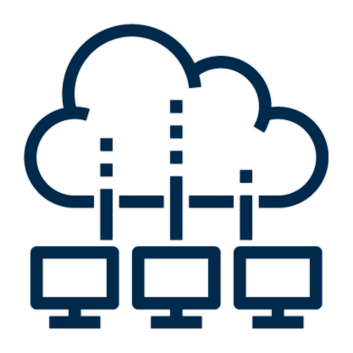


#DevSecOpsWhat
Notes:
Every year we hear buzz words that you can’t get away from. Agile, Cloud Migration, Digital Transformation, DevSecOps. But DevSecOps isn’t new; we had development, operations, and security for a long time. So what is so difference about DevSecOps?
DevOps, in its simplest terms, is the automation of the series of steps needed to take code from a repository to a production environment. Now to introduce Security into the mix is to apply processes and controls that decrease the attack surface open to hackers.
A mature organisation with well established DevSecOps processes can perform hundreds of secure, repeatable, and reliable deployments a day, however, like more things this is possible through more than just tooling. It is always a combination of people, process, and technology.

Slide 10




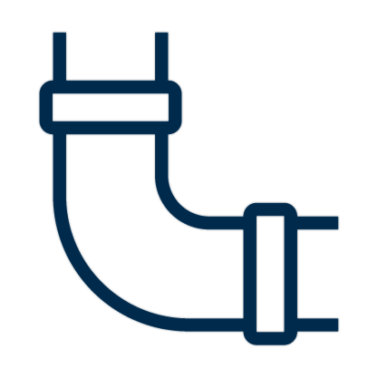



#DevSecOpsWhy
Shifting Left
Notes:
Another big buzz word at the moment is “shift left”. Originally related to testing; test early and test often; the phrase has been adopted by every section of technology including Service Desk, Operations, and even Cyber.
But the practice of “shifting left” has gone even further with hackers now adopting it. Why wait until code has been released to hardened production environments when they could attack the source.
Has anyone here ever thought about contaminating the water supply? Or is it just me?
If you where feeling wilful, you could go to someone’s house and put something in their expensive coffee machine. But what if you wanted to contaminate the whole street?
Well, the best delivery system is through the water taps. So, we would go to each house, we’d go to the end of the road and contaminate the water via a manhole.
What if we wanted to contaminate the whole estate? Again, we could go to every street and find the manhole, or we could go to the main supply for the area and contaminate there.
But what if we were feeling malicious and want to affect the whole town? We’d go to the water plant and start things there. Then we might realise that the water that feeds this water plant, and others, comes from a reservoir. We’ve now found our source, that if poisoned has the potential to affect hundreds if not thousands of homes.
“But wait”, I hear you grumble, “there are controls, fences, gates, staff, alarms, we won’t get in.”
“Ah-ha” I say, “what if the water company hasn’t thought about protecting the source?”
With DevSecOps we look to produce and protect code from development, to repo, through build and deployment, to production.
And to draw this scenario to a close, you could also poison the Cloud and cause toxic rain … but that’s a whole other presentation!
If this sounds familiar, it’s the plot of multiply TV programs and films.
A series of cyberattacks on water facilities highlight the precarious security situation facing supplies. In 2021 alone there were attacks in Italy, Florida, and others.

Slide 11




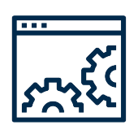

#DevSecOpsHow
Culture
Infrastructure
Secure code training
Peer reviews
Unit testing
Coding champion
Threat modelling
Coding standards
First warning … stop reading!
Image library source
Server hardening
Patching
Gold image curation
Networks and firewalls
Automatic provisioning
Developer Tooling
Monitoring
DevSecOps
IDE
Package Management
Application Lifecycle Management
Ticketing system
DAST tooling
Source control
Logging
Metrics
Analysis
Reporting
Threat intelligence
Evidence as policy
Slide isn’t meant to be read
Process Chain
(abridged!)
Deployment
Operations
Build pipelines
SAST tooling
Automated testing
Deployment environments
Automatic fault reporting
DAST tooling
Secrets management
Stop reading this slide!
Support
Service desk
Continuous monitoring
Vulnerability management
Security scanning
Policy enforcement
Notes:
Now, before everyone starts to Google how to get a borehole and build a fallout shelter, lets look at the “how”.
These next two slides are “anti-best practice slides”! Don’t read them, they are to enforce a point about DevSecOps.
To “do” DevSecOps it is no longer enough to trust in our developer’s abilities and secure the platform they are deploying to. We have to “shift left”!
We could rush out and buy tools, or source free applications that will promise to do everything for us, but we all know how that ends. Experience has taught me that to make the implementation of something like DevSecOps a success, we need people, processes, and technology.
You can read articles and listen to talks about DevSecOps success stories. Netflix have automated everything. Microsoft are super-Agile and deploy every 2 seconds. The Pokemon company provide extensive training to all technical staff.
You can attend conferences and see hundreds of vendors that will secure your platform or scan your code every few minutes. You can even do it all for free; search the Internet, watch some YouTube videos, and use open-source tooling. There are a lot of options!

Slide 12
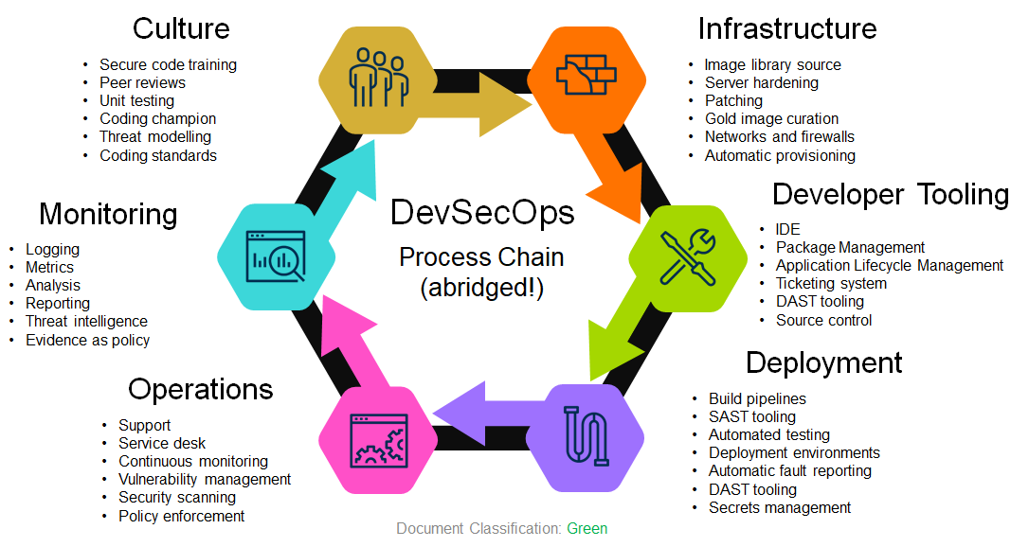
#DevSecOpsHow
The DevSecOps
Toolchain
Infrastructure
Culture
Azure Virtual Machines
Amazon Machine Images
GCP Compute Engine
Docker
ECR
Terraform
YAML
Ansible
Chef
SaltStack
AWS CloudFormation
Azure Resource Manager
CIS Benchmarks
SCCM
Qualys Patch Management
Automatic Updates
Code Warrior
Pluralsight
OWASP Top 10
LinkedIn Learning
Udemy
Evil user stories
CERT Secure Coding Standards
Game day exercises
Gerrit
Github pull requests
Review board
JUnit
xUnit
Evil user stories
OWASP Threat Dragon
CERT Secure Coding Standards
Monitoring
Developer Tooling
Azure Defender for Cloud
Azure Sentinel
Splunk
SolarWinds
RSA NetWitness
Archer
ThreatConnect
OWASP Threat Dragon
Chef
HashiCorp Sentinel
nmap
Etsy Morgue
Orca Security
HackerOne
graphite
Wiz.io
NPM
NodeJS
SonarLint
DeepSource
SonarQube
JetBrains
Github
GitLab
BitBucket
Azure DevOps
Github Actions
JIRA
Artifactory
ReSharper
Final warning! Stop it!
VSCode
Operations
Deployment
BMC Remedy
ServiceNow
LinkedIn Learning
Udemy
Evil user stories
OWASP Threat Dragon
CERT Secure Coding Standards
Qualys
Tenable
Spiceworks
BeyondTrust
AWS CloudTrail
Nessus
Seriously … stop reading! You will hurt your eyes.
Jenkins
Azure DevOps
AWS Deploy
VeraCode
Fortify
Selenium
TestComplete
Azure Key Vault
AWS KMS
Atlassian Bamboo
TeamCity
YAML
PowerShell
SARIF SAST Tools
Yarn
Test Management
(VERY abridged!)
Notes:
Unfortunately this leads to another problem. Things can become overwhelming and when you try to do everything at once, you do nothing well.
So, we are going to start small and build. With projects like RT2 and Cloud Transformation we can build on our experience and bake-in security processes at an early stage.
Using tools and processes that support things like Infrastructure as Code we can create and maintain hardened VMs for our emergency lift-and-shift projects.
By working with developers we ca move away from our on premise mind-set and start utilising the native resources in the Cloud.
By setting policies we can allow Delivery to work in a secure wat without limiting innovation.
And by supporting the DevOps processes we can enable secure, reliable, and repeatable deployments for our operational teams and the Business.

Slide 13
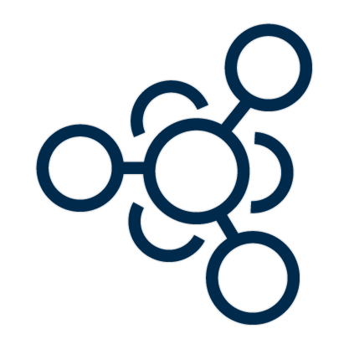

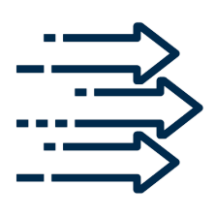


#DevSecOpsWho
Ops
Ops
Dev
Sec
Dev
Sec
On
Prem
Cloud
RT2
Cloud
Notes:
This all sounds like a lot of work. Who is going to do it?
With a small core team, and the support of colleagues across Technology and the Business, we plan to build secure ways of working with best practices processes and industry leading tooling.
We are already engaged with a cloud monitoring company, Wiz.io, for a PoC. A company like Wiz will allow us to report on our Cloud Security Posture Management and identify areas of concern and opportunities for improvement. The feedback from CSPM will provide actions to update process and improve policies.
But this isn’t all about Cloud. Working with RT2 and other on premise application teams we will be supporting secure development lifecycle process and ensuring consistency across Technology.

Slide 14



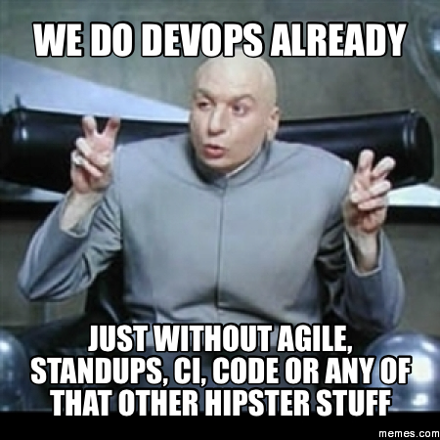



#DevSecOpsWhen
Notes:
I’ve been reliably informed that every presentation needs a meme, so here is mine.
As mentioned, we’ve already started, but we have a lot more work to do to identify where we are in our maturity. Some of our developer teams use secure working practices such as protected repository branches, fewer have integrated build and deployment pipelines, and fewer still have automated tasks for testing and code review.
Understanding where we are will allow us to plan and prioritise the most effective next steps.
Will we ever be Netflix or Microsoft? No. We are not a worldwide streaming service, nor a global – whatever Microsoft is, and it has taken these companies a decade to become the unicorns everyone talks about.
So, we’ll start small, implement change, and always review if there has been a positive impact. We, all of us in Security, can be an enabler, helping produce better architecture, more secure code, better role-based security. But it’s going to take time.

Slide 15
Questions

